Slide 1
File & Directory Names
All file names are case sensitive.
You can use upper and lowercase letters, numbers, “.” (dot), and “_” (underscore) symbols.
You can use other special characters such as blank space.
No need to use . (dot) in a filename.
Most modern Linux and UNIX limit filename to 255 characters (255 bytes).
A filename must be unique inside its directory.

Slide 2
Absolute & Relative Path Names
Absolute Path :
is defined as the specifying the location of a file or directory from the root directory(/).
In other words we can say absolute path is a complete path from start of actual filesystem from / directory.
Relative Path is defined as path related to the present working directory(pwd).

Slide 3
Listing Directory contents
You can list the contents of a directory with ls.
Options | Description
ls -a | List all files including hidden file starting with '.'
ls --color | Colored list [=always/never/auto]
ls -d | List directories - with ' */'
ls -l | List with long format - show permissions
ls -i | List file's inode index number
ls -r | List in reverse order
ls -s | List file size
ls -S | Sort by file size
ls -t | Sort by time & date

Slide 4
Coping, Moving, Renaming Files & Directories
Copying Files
To copy file Abc.txt to the directory demo in your login directory just type: Syntax: cp <source> <destination>
cp Abc.txt demo
Moving Files
To move files, use the mv command.
With mv the file is physically moved from one place to another.
Renaming Files
when you copy or move files, you can also rename.
Deleting Files and Directories
When you no longer need a file, use rm to remove it.

Slide 5
Nautilus
Most people will be used to using graphical tools to copy files from their disks. If you are used to using Windows then you will be aware of a tool called Windows Explorer which makes it very easy.
Windows Explorer is a tool known as a file manager and Linux has a number of different file managers
file manager is called Nautilus.

Slide 6
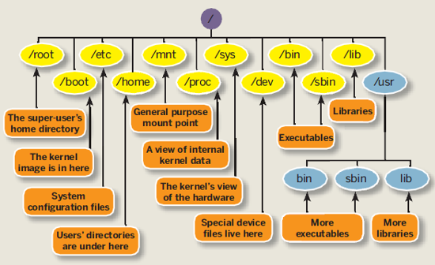
File Structure

Slide 7
Partitions
View all Disk Partitions in Linux
The ‘-l‘ argument stand for (listing all partitions) is used with fdisk command.
View Specific Disk Partition in Linux
To view all partitions of specific hard disk use the option ‘-l‘ with device name.
Check all Available fdisk Commands
Use /dev/sda after mentioning hard disk name.
Then type ‘m’ to see the list of all available commands of fdisk.
Print all Partition Table in Linux
How to Delete a Partition in Linux
How to Create a New Partition in Linux
press “n” command to create a new partition.
Press “p” for primary partition and “e” for extended partition.
How to Format a Partition in Linux
How to Check Size of a Partition in Linux
fdisk –s /div/sda2
How to Fix Partition Table Order

Slide 8
INODE
An inode is a data structure on a filesystem on Linux that stores all the information about a file except its name and its actual data.
The metadata includes
The size of the file .
The file's owner and group.
The file's access permissions.
Timestamps.
Reference number of hardlinks.
Notes:
Stat file name

